Slide 1
BSC performance analysis tools
Jesús Labarta, Judit Gimenez
BSC

Slide 2
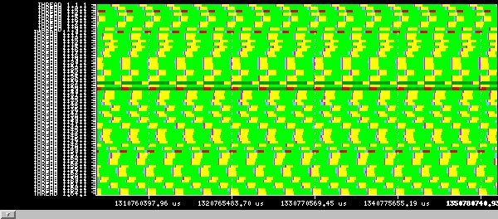
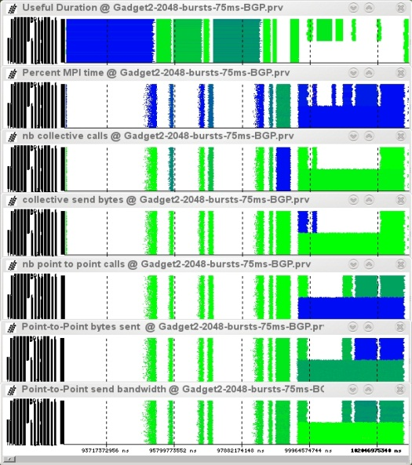
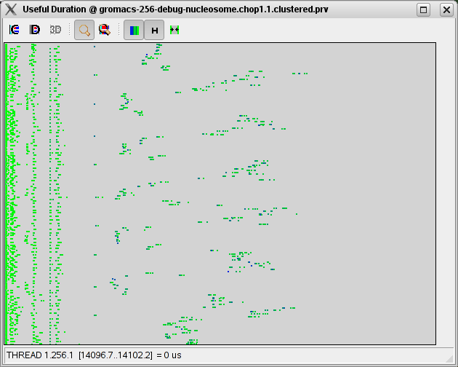
Our Tools
Since 1991
Based on traces
Open Source
http://www.bsc.es/paraver
Core tools:
Paraver (paramedir) – offline trace analysis
Dimemas – message passing simulator
Extrae – instrumentation
Focus
Detail, flexibility, intelligence (analytics)

Slide 3
What is Paraver
A browser …
…to manipulate (visualize, filter, cut, combine, …) ….
… sequences of time-stamped events (traces) …
… with a multispectral philosophy …
… and a mathematical foundation …
… that happens to be mainly used for performance analysis

Slide 4
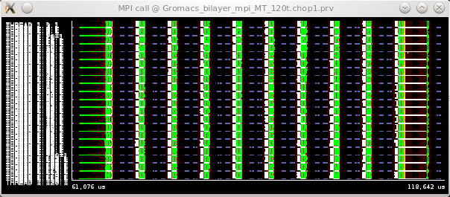
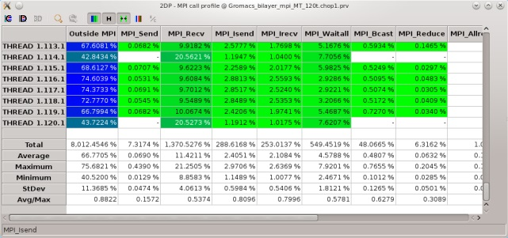
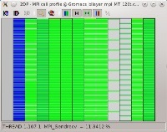
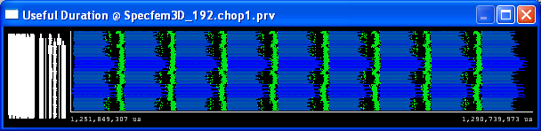
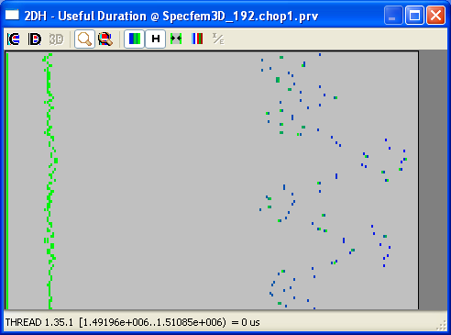
Paraver mathematical foundation
Trace
Filter
Sub-Trace / subset of records
Semantic
(S₁,t₁), (S₂,t₂), (S₃,t₃),…
Display
Function of time
Series of values
MPI calls
MPI calls profile
Useful Duration
Histogram Useful Duration

Slide 5
Performance Analytics
Dominant practice
We focus a lot on capturing a lot of data
but we present either everything or first order statistics
and require new experiments without squeezing the potential information from the previous one
Need for performance analytics
Leveraging techniques from data analytics, mining, signal processing, life sciences,…
towards insight
And models
Some techniques worked on at BSC
Spectral analysis
Clustering
Folding
Simulation (Dimemas)

Slide 6
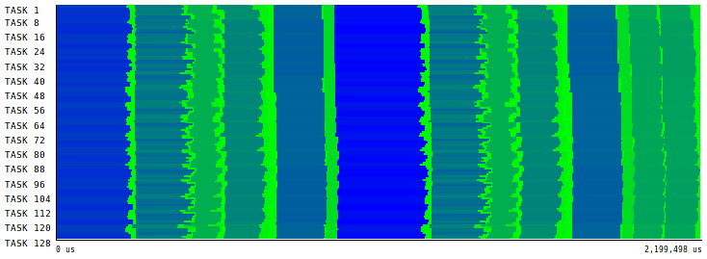
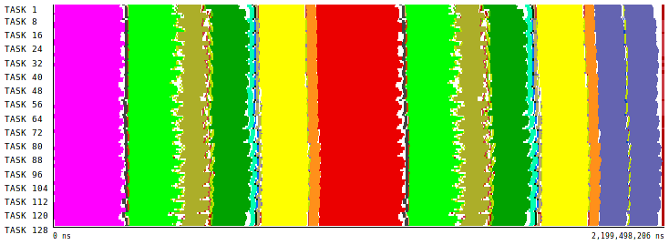
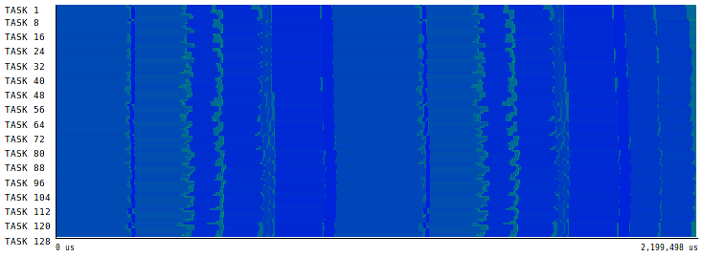
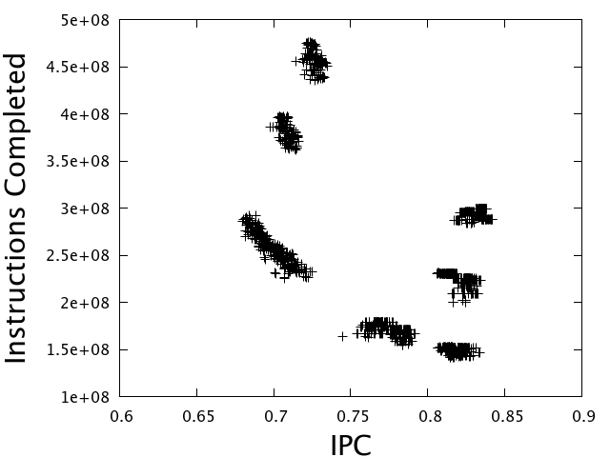
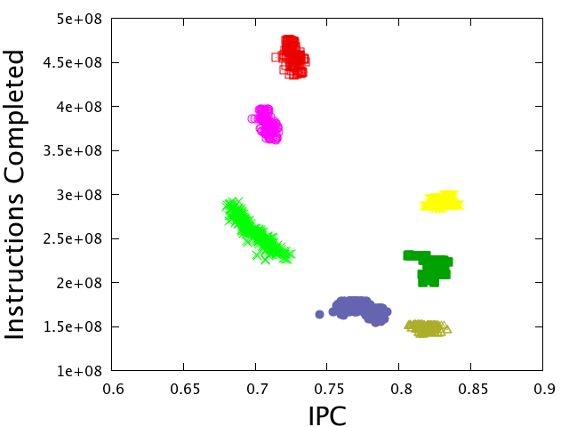
Using Clustering to identify structure
Completed Instructions
IPC
J. Gonzalez et al, “Automatic Detection of Parallel Applications Computation” Phases. (IPDPS 2009)

Slide 7
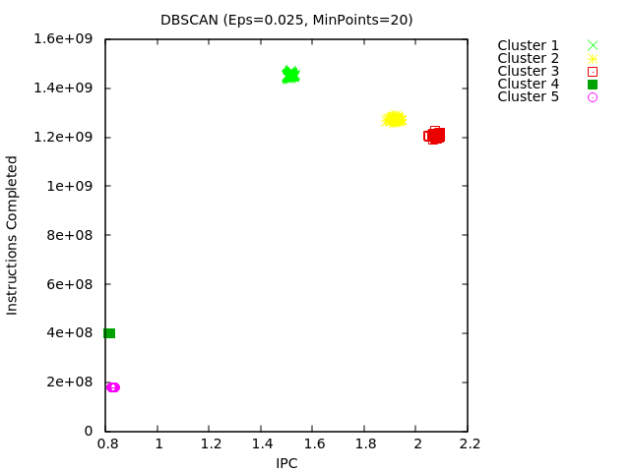
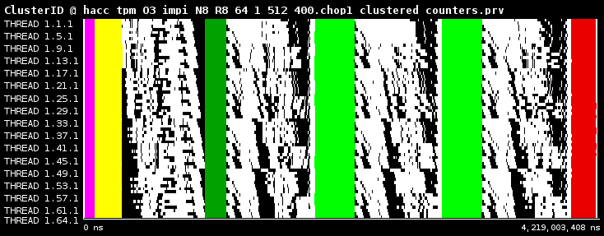
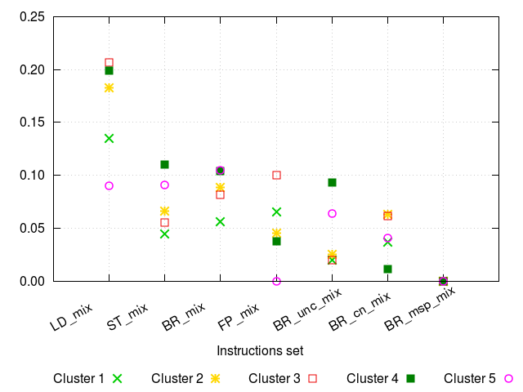
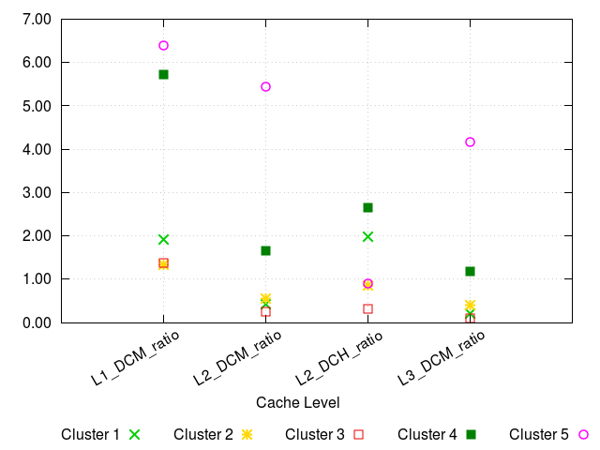
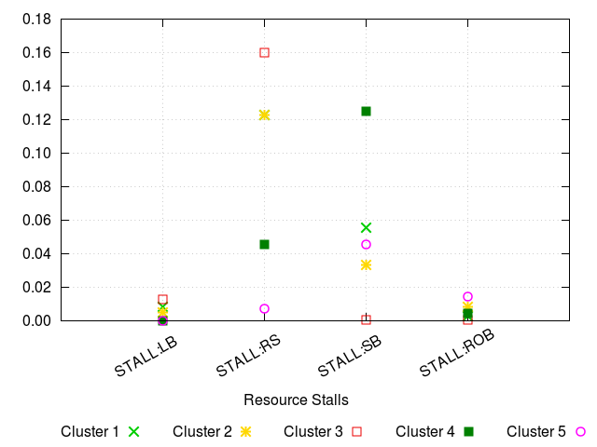

Projecting hardware counters based on clustering
Full per region HWC characterization from a single run
Instruction mix
Miss ratios
Stalls
González J. et al , “Performance Data Extrapolation in Parallel Codes”. ICPADS '10

Slide 8
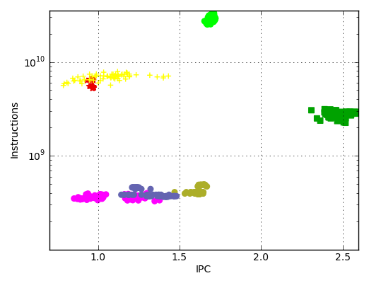
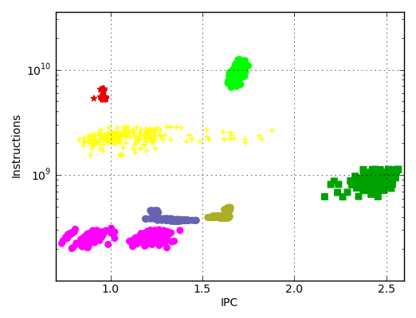
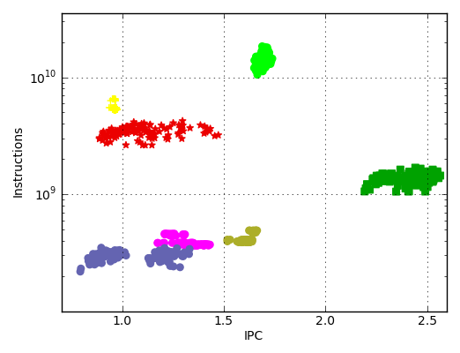
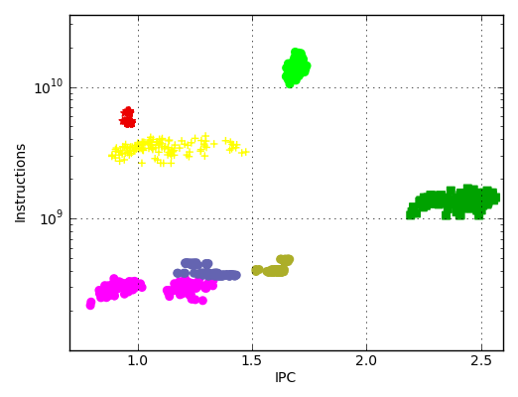
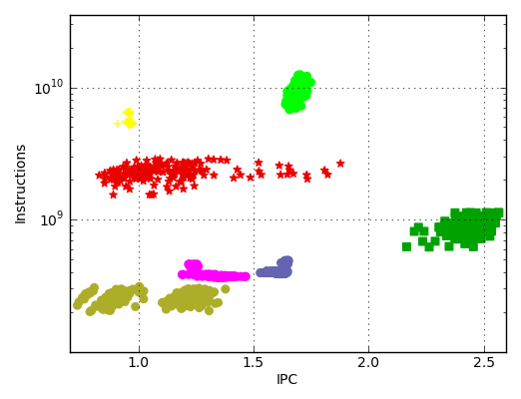
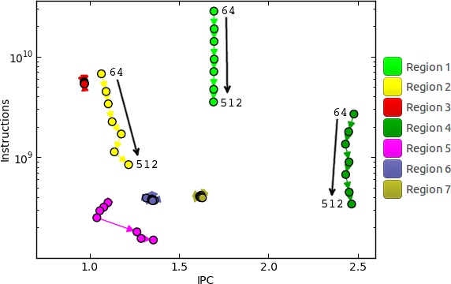
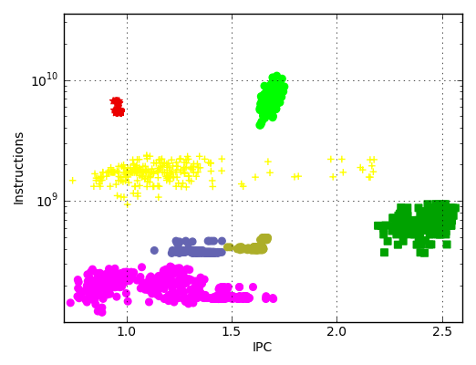
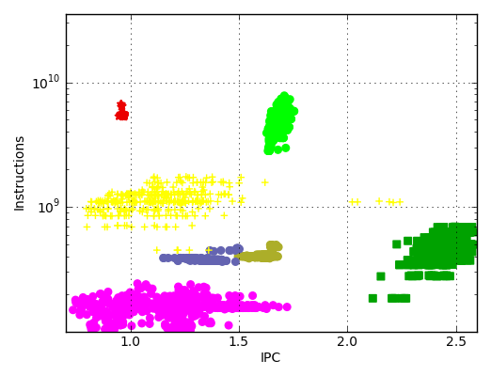
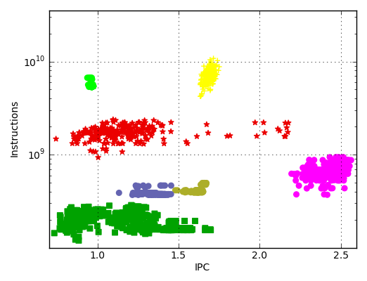
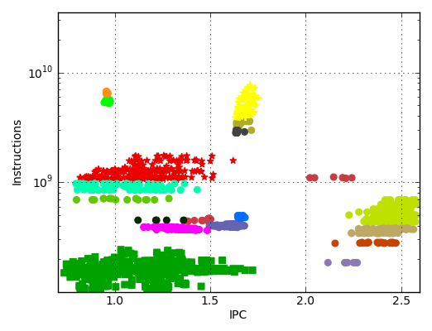
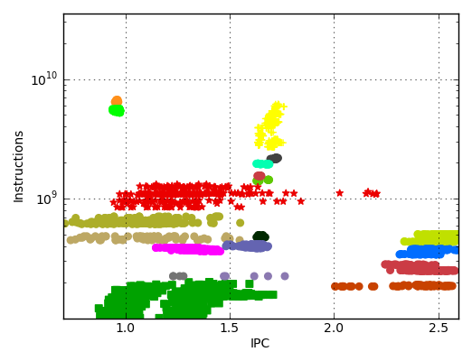
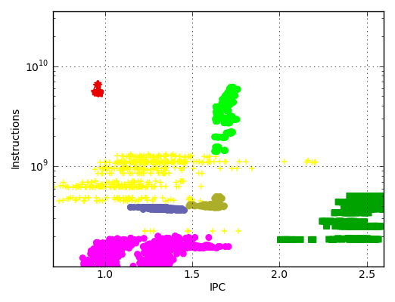
Tracking structural evolution
Frame sequence: clustered scatterplot as core counts increases
OpenMX
Strong scaling
64
64
128
128
192
192
512
256
512
256
384
384
G.Llort et all, “On the Usefulness of Object Tracking Techniques in Performance Analysis”, SC 2013

Slide 9
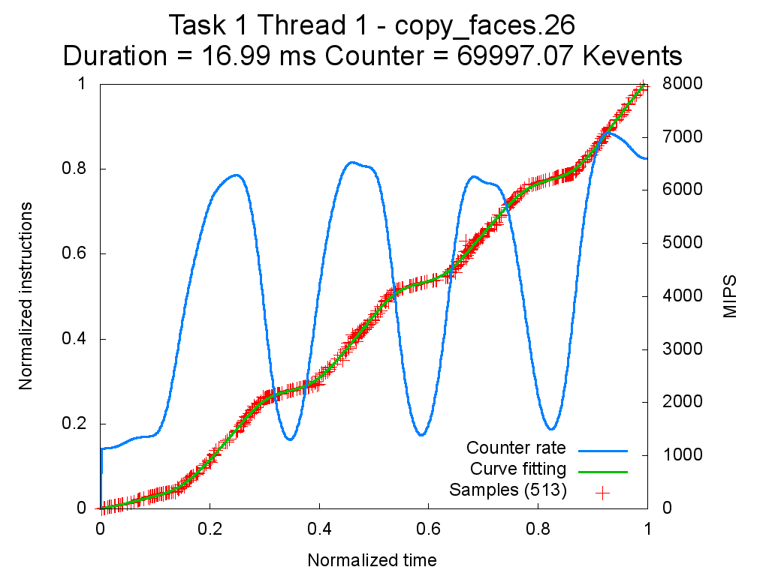
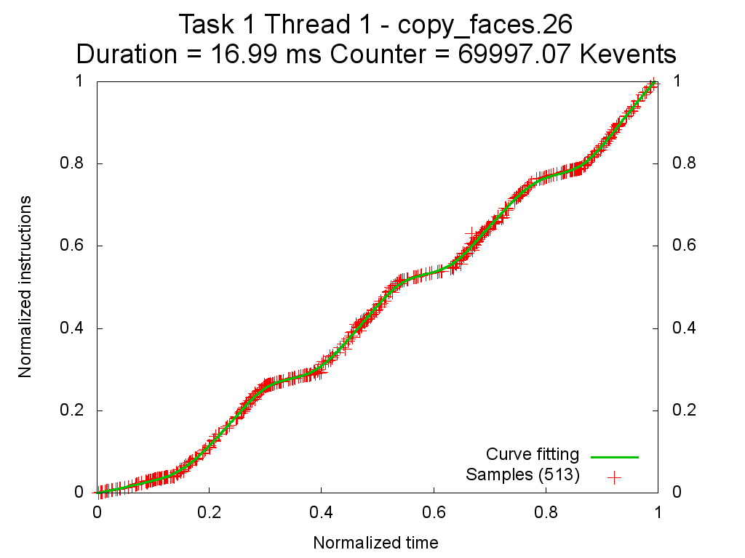
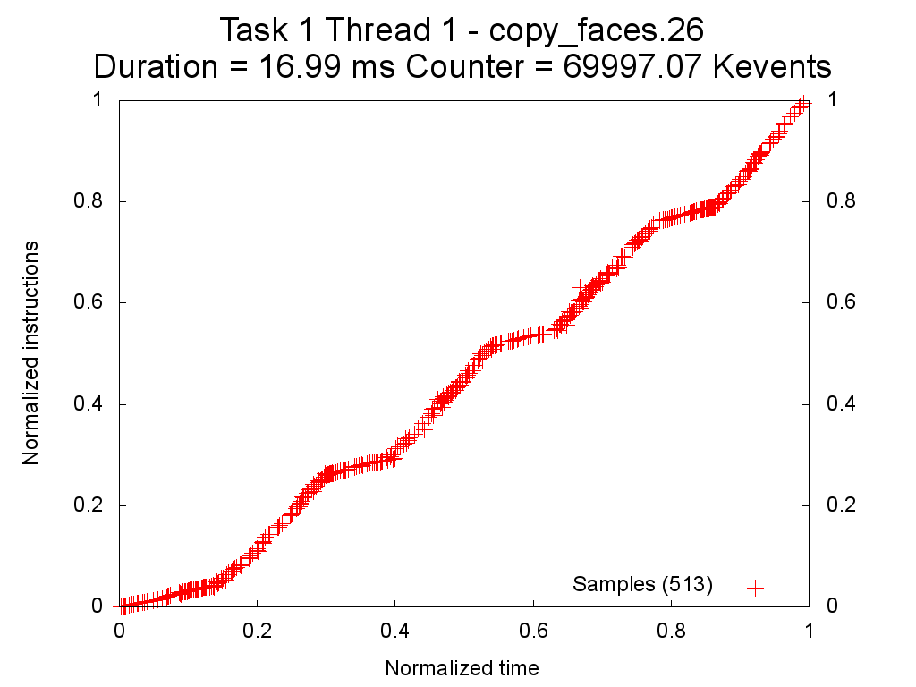
Instantaneous metrics at “no” cost
… to get extreme detail with minimal overhead
Iteration #1
Iteration #2
Iteration #3
Synthetic Iteration
Red crosses represent the folded samples and show the completed instructions from the start of the routine
Green line is the curve fitting of the folded samples and is used to reintroduce the values into the tracefile
Blue line is the derivative of the curve fitting over time (counter rate)
Harald Servat et al. “Detailed performance analysis using coarse grain sampling” PROPER@EUROPAR, 2009
Harald Servat et al. “Unveiling Internal Evolution of Parallel Application Computation Phases” ICPP 2011

Slide 10
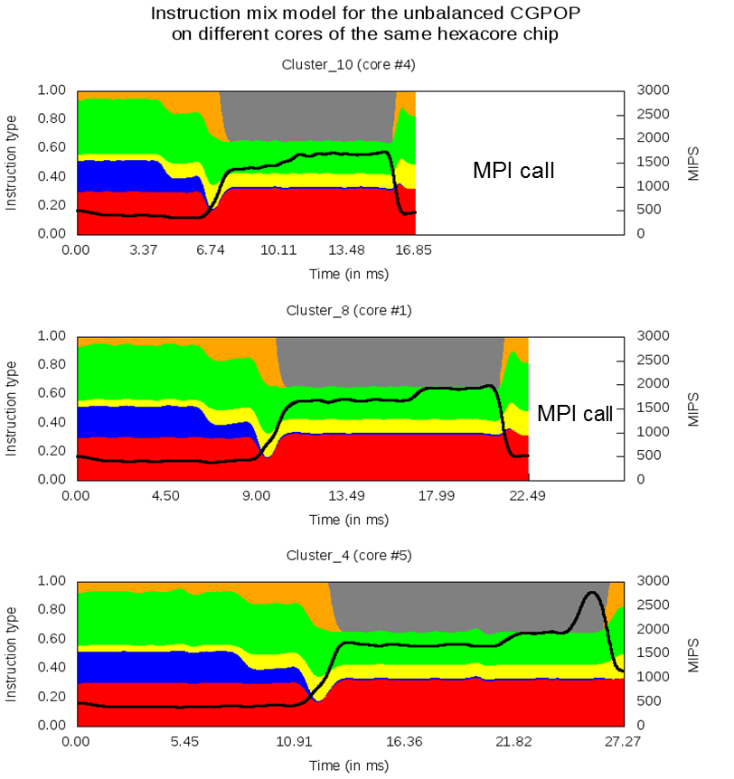
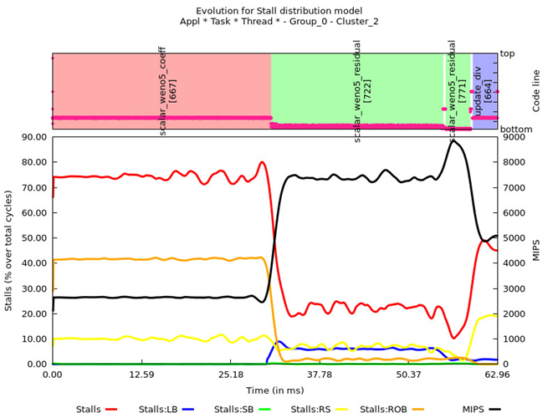

Instantaneous metrics at “no” cost

Slide 11
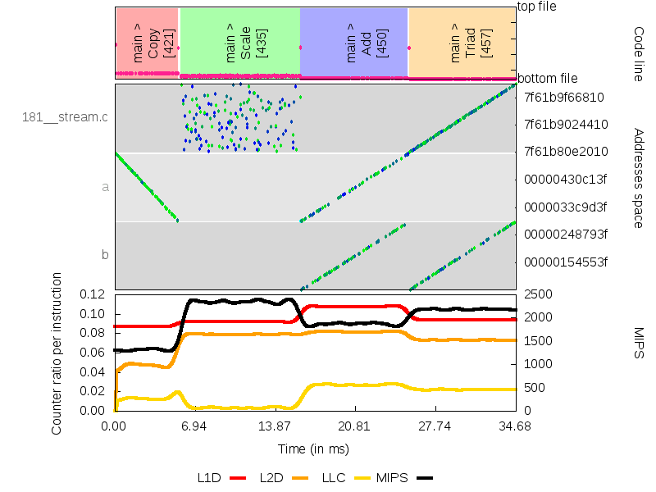
… and memory access patterns
Modified Stream
Load references
for i = 0; i < NITERS; i++
{
for (j = 0; j < N; j++)
c[j] = a[j];
for (j = 0; j < N/8; j++)
b[j] = s*c[random(j)];
for (j = 0; j < N; j++)
c[j] = a[j]+b[j];
for (j = 0; j < N; j++)
a[j] = b[j]+s*c[j];
}

Slide 12
Dimemas: Coarse grain, Trace driven simulation
Simulation: Highly non linear model
Linear components
Point to point communication
Sequential processor performance
Global CPU speed
Per block/subroutine
Non linear components
Synchronization semantics
Blocking receives
Rendezvous
Eager limit
Resource contention
CPU
Communication subsystem
links (half/full duplex), busses
B
L
L
L
CPU
Local
CPU
Local
CPU
Local
CPU
Memory
CPU
Memory
CPU
Memory
CPU
CPU
CPU

Slide 13
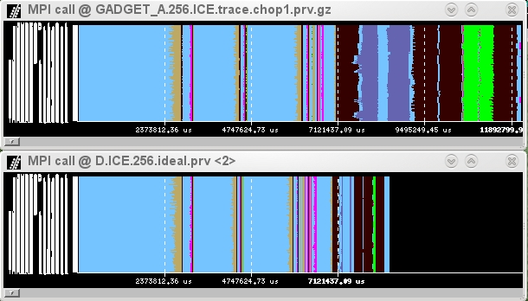
Ideal machine
The impossible machine: BW = ∞, L = 0
Actually describes/characterizes intrinsic application behavior
Load balance problems?
Dependence problems?
Allgather
+
sendrecv
alltoall
GADGET @ Nehalem cluster
256 processes
allreduce
sendrec
waitall
Real
run
Ideal
network

Slide 14
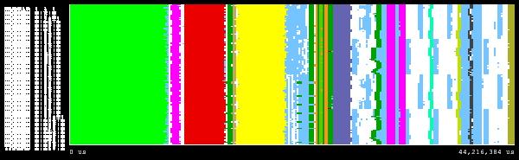
Integrating models and analytics
Expectations of Hybrid parallelization?
Beware of the hybrid Amdahl’s law
→ asynchrony + dynamic load balancing mechanisms !!!
GADGET, 128 procs
%elapsed time
Code region
93.67%
97.49%
99.11%

Slide 15
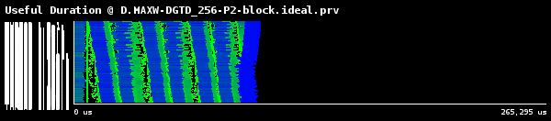
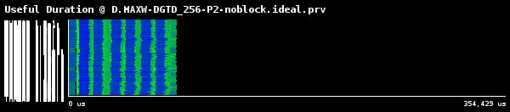
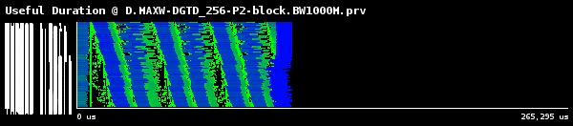
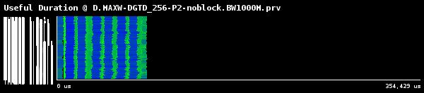
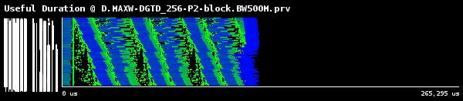

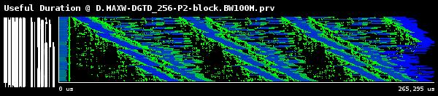
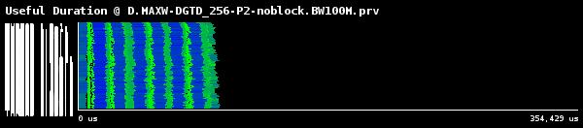
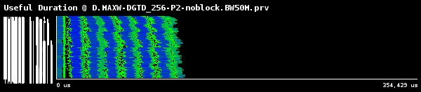
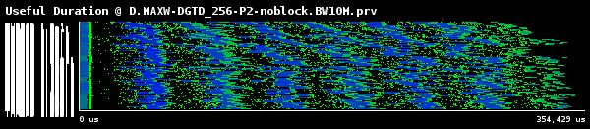
Sensitivity to network bandwidth
ideal
1000 MB/s
500 MB/s
100 MB/s
50 MB/s
10 MB/s

Slide 16
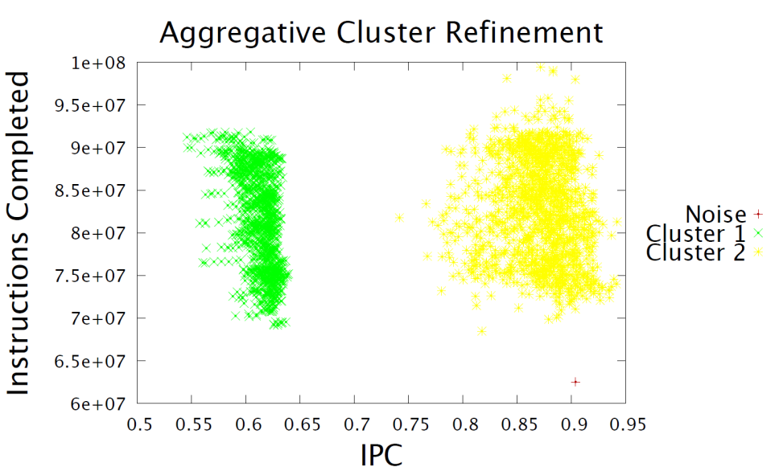
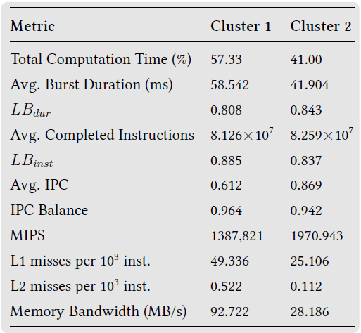
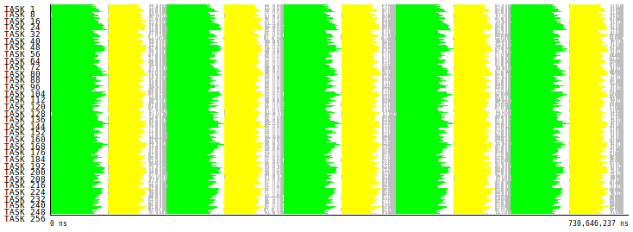
Integrating models and analytics
PEPC

Slide 17







How can we improve the application?
What if ….
… we increase the IPC of Cluster1?
13% gain
… we balance Clusters 1 & 2?
19% gain

Slide 18
Analytics: sqeeze data → insight
Fundamental behavior model
Load balance
Serialization
Transfer
Explains bottleneck …
…how they migrate …
… and combined effect
Guides tuning work in the most productive direction
GROMACSv4.5
M. Casas et al, “Automatic analysis of speedup of MPI applications”. ICS 2008.

Slide 19







Powerful analysis …
Identify relevance of different factors …
… trends and outliers
In conjunction with detailed analysis of individual points
IPC variability
Several core counts
MPI progression engine issue
AVBP @ Juropa
eff_factors.py
eff.csv
AMG2013 @ MareNostrum

Slide 20



Powerful what ifs …
Can eliminate CPU noise
prv2dim
.dim
.dim
.dim
.dim
Several core counts
Dimemas
Eliminate network/MPI noise
Model hypothetical target platforms
eff_factors.py
eff.csv
extrapolation.py
“Scalability prediction for fundamental performance factors ” J. Labarta et al. SuperFRI 2014
No MPI noise
+ No preemption noise

Slide 21
PARAVER

Slide 22
What is Paraver
A browser …
…to manipulate (visualize, filter, cut, combine, …) ….
… sequences of time-stamped events …
… with a multispectral philosophy …
… and a mathematical foundation …
… that happens to be mainly used for performance analysis

Slide 23



Paraver – Performance data browser
Trace visualization/analysis
Raw data
+ trace manipulation
Timelines
Goal = Flexibility
No semantics
Programmable
2/3D tables (Statistics)
Comparative analyses
Multiple traces
Synchronize scales
Notes:
We present an alternative to deal with the traces scalability problem. Nowadays, is not surprising to have 10k processes that run for hours. Quickly evolving to the Petascale.
Blind tracing produces huge data volumes.
Even profilers can face scalability issues.
Once you try to gather such data volume, the first question is... can you store it?
Even if you can, the amount of time required to parse/process/manipulate that can be high. If the tool is not responsive enough, what's the acceptable amount of time for you to wait?

Slide 24
Paraver mathematical foundation
Every behavioral aspect/metric described as a function of time
Possibly aggregated along
the process model dimension (thread, process, application, workload)
The resource model dimension (core, node, system)
Language to describe how to compute such functions of time (GUI)
Basic operators (from) trace records
Ways of combining them
Those functions of time can be rendered into a 2D image
Timeline
Statistics can be computed for each possible value or range of values of that function of time
Tables: profiles and histograms

Slide 25

Paraver mathematical foundation
Function of time
Series of values
Trace
Filter
Sub-Trace / subset of records
Semantic
(S₁,t₁), (S₂,t₂), (S₃,t₃),…
Display

Slide 26
Timelines
Each window displays one view
Piecewise constant function of time
Types of functions
Categorical
State, user function, outlined routine
Logical
In specific user function, In MPI call, In long MPI call
Numerical
IPC, L2 miss ratio, Duration of MPI call, duration of computation burst

Slide 27





Timelines
Representation
Function of time
Colour encoding
Not null gradient
Black for zero value
Light green → Dark blue
Non linear rendering to address scalability
J. Labarta, et al.: “Scalability of tracing and visualization tools”, PARCO 2005

Slide 28
Basic functions of time
The filter module presents a subset of the trace to the semantic module. Each thread is described by
A sequence of events , states and communications
For each event let be its time and its value
For each state let be its start time its stop time and its value
For each Communication let be its send time, its receive time, its size.
and identify the partner process and direction of the transfer
Semantic module builds
Trace
Filter
Semantic
Display
Function of time
Series of values

Slide 29




Basic functions of time
See slides at end of presentation for details

Slide 30
Paraver engine
An interpreter for the configuration language (DSL)
GUI
Configuration files
Trace
Configuration files
Distribution
Your own
Filter
Configuration
Semantic
Display
Demand
driven
evaluation

Slide 31


Tables: Profiles, histograms, correlations
From timelines to tables
MPI calls profile
MPI calls
Histogram Useful Duration
Useful Duration

Slide 32


Tables
See slides at end of presentation for details

Slide 33












Analyzing variability through histograms and timelines
Useful Duration
IPC
Instructions
L2 miss ratio

Slide 34




Analyzing variability through histograms and timelines
By the way: six months later ….
Useful Duration
IPC
Instructions
L2 miss ratio

Slide 35









3D Tables
An additional control dimension
One table (plane) per value (or range) of 3D window
i.e. histogram of duration of each function
User functions
Duration

Slide 36




From tables to timelines
Where in the timeline do the values in certain table columns appear?
ie. want to see the time distribution of a given routine?
Only showing when a given value happens

Slide 37



Variability … is everywhere
Hydro MPI @ 8 cores
In space … and time
Useful instructions Histogram: 2.12e6 – 3.00e6]
Color: average IPC: [0,5 – 0.94]
[2.12e6 – 3.00e6]
[2.12e6 – 2.24e6]
Very small spatial and long term
computational variability
for a specific behavioral region

Slide 38





Variability … is everywhere
CESM: 16 processes, 2 simulated days
Histogram useful computation duration shows high variability
How is it distributed?
Dynamic imbalance
In space and time
Day and night.
Season ? ☺

Slide 39
Other mechanisms integrated in the GUI
Trace manipulation
Cut
Filter
Performance analytics
Clustering
Folding
Tracking
Executing external commands an tools
BSC Tools
Scripts
External tools

Slide 40





Trace manipulation
Data handling/summarization capability
Filtering
Subset of records in original trace
By duration, type, value,…
Filtered trace IS a paraver trace and can be analysed with the same cfgs (as long as needed data kept)
Cutting
All records in a given time interval
Only some processes
Software counters
Summarized values computed from those in the original trace emitted as new even types
#MPI calls, total hardware count,…
WRF-NMM
Peninsula 4km
128 procs
570 s
2.2 GB
MPI, HWC
570 s
5 MB
4.6 s
36.5 MB
See slides at end of presentation for details

Slide 41
External commands and tools
Execute external commands …
Predefined: Dimemas, Stats,…
User specified binaries or scripts
… specifying arguments
Trace
Command specific arguments
Paramedir
Non graphical version of Paraver
Reads trace, applies standard cfgs, writes ASCII output (table,…)
Scripts can use paramedir, Dimemas, clustering … in parametric sweeps, search/optimization loops,…

Slide 42
Executing external commands
Example: basic_analysis.py
==================================================================
Analysis of XXXXX.prv
==================================================================
Timing:
Elapsed duration = 3.887 s
Ideal time = 3.223 s
Compute time = 2.637952 s
MPI time = 1.24930663 s
Parallel Efficiency:
Total Efficiency = 0.679
Load Balance = 0.950
Micro Load Balance = 0.859
Transfer = 0.829
Bweff = 0.814
Leff = 1.000
Load balance:
Time Load Balance = 0.950
Instructions Load Balance = 0.990
Cycles load balance = 0.950
IPC Load Balance = 0.960
Computational analysis:
Total useful instructions = 5.399636e+11
Average useful instructions per process = 8.436931e+09
Instructions based microload balance/sync = 0.924
sequential performance:
Average MIPS = 3199
Average IPC = 1.050
Basic communication statistics:
Point to point:
Average number of calls = 554.0
Balance in number of calls = 1.0
Average bytes per process = 728596480.0
Balance in bytes = 0.990
Collectives:
Num collective calls = 6.0
Average bytes per call = 6.670
Max bytes per call = 8.000
Balance in bytes = 1.000
Inter - Intra node communication statistics:
Bytes sent (MB):
Locally = 22229.811
Remotely = 24645.730
Number of sends:
Locally = 3520.000
Remotely = 6592.000
64Proc – 8 MPI by node

Slide 43
Interoperability
Paraver can be driven from external tools
When receiving a signal it will load a given configuration file
Integration with Scalasca-CUBE
Point directly to regions in time where a given metric is high

Slide 44
BSC Tools web site
www.bsc.es/paraver
downloads
Sources / Binaries
Linux / windows / MAC
documentation
Training guides
Tutorial slides
Getting started
Start wxparaver
Help → tutorials and follow instructions
Follow training guides
Paraver introduction (MPI): Navigation and basic understanding of Paraver operation

Slide 45
EXtrae

Slide 46
Trace
Sequence of time stamped records
Punctual events
Something happened: when and where (object/entity: … thread)
One record per specific information (encoded as a type and a value)
About the event
About the interval from the previous event till this one (i.e. hardware counts,…)
Relations between objects (… communications)
Source and sink
Attributes (… size, tag)
Separate numeric (.prv) and symbolic (.pcf) files
Only information derived from captured events and data can be reported.
Trivial but … often forgotten

Slide 47
Extrae
Major BSC instrumentation package
When / where
Parallel programming model runtime
MPI, OpenMP, pthreads, OmpSs, CUDA, OpenCL, MIC…
API entry/exit, OpenMP outlined routines
Selected user functions
Periodic/hwc overflow samples
User events
Notes:
Read what Extrae can instrument.
* Counters, frequently like PAPI or at some points like network counters or OS counters.
* As opposite to other tools, we default to no instrument user functions because we are confident that callstack at MPI calls provides a good initial insight to study the application.

Slide 48
Extrae
Additional information
Counters
PAPI
Network counters
OS counters
Link to source code
Callstack
OpenMP outlined routines and their containers
Selected user functions
Extrae API:
On/off
User events
Notes:
Read what Extrae can instrument.
* Counters, frequently like PAPI or at some points like network counters or OS counters.
* As opposite to other tools, we default to no instrument user functions because we are confident that callstack at MPI calls provides a good initial insight to study the application.

Slide 49

How does Extrae intercept your app?
LD_PRELOAD
Works on production binaries
Specific library for each combination of runtimes
Does not require knowledge on the application
Dynamic instrumentation
Works on production binaries
Just specify functions to be instrumented.
Other possibilities
Link instrumentation library statically (i.e., PMPI @ BG/Q, …)
OmpSs (instrumentation calls injected by compiler + linked to library)
Based on DynInst
U.Wisconsin/U.Maryland
Notes:
How does Extrae work?
Extrae basically injects monitor into the application. There are different ways to inject such monitors including DynInst, which modifies the application in memory and using the LD_PRELOAD, which is used to substitute symbols in the shared librarie within the application before it gets executed.
No matter the mechanism chosen we inject monitors that emit information regarding the placement, the timestamp and also additional metrics like performance counters or the callstack.
Hacer que escojan una para el hands-on.

Slide 50
How to use Extrae?
Adapt job submission script
Specify LD_PRELOAD library and xml instrumentation control file
Specify the data to be captured in the .xml instrumentation control file
Run and get the trace …
Extrae 2.3.4 User's Guide available in
http://www.bsc.es/computer-sciences/performance-tools/documentation
Default control files and further examples within installation in
$EXTRAE_HOME/share/example
Notes:
Using Extrae is rather simple. You should just to adapt your job submission script. This involves telling the launcher to execute Extrae in front of the target application and passing a configuration file for Extrae. Once this is done, you only need to run the application normally.

Slide 51
Spectral analysis

Slide 52
Repetitive behavior
Applications tend to have Iterative behavior
Detailed analysis can be applied to a few such iterations
Metrics in Paraver are functions of time
Natural target for signal processing techniques to automatically detect such iterative structure
Relevant functions of time at global application level
# processes in MPI, outside MPI, …
Sum of useful burst duration
Semantic: high when many processes are in the middle of very long computation bursts
Does capture repetitive structure of application

Slide 53







Signal processing applied to performance analysis
Techniques
Mathematical morphology
clean up perturbed regions
Wavelet transform
identify coarse regions
Spectral analysis
detailed periodic pattern
Useful
Identify structure (periodicity)
Reduce trace sizes
Increase precision of profiles (report non perturbed stats)
Flushing
Flushing
filtered
Wavelet
High
frequency
Σ Useful Duration
Spectral density
Autocorrelation
T

Slide 54
Signal processing applied to performance analysis
Hierarchical structure identification
M. Casas et al., “Automatic structure extraction from MPI applications tracefiles,” Euro-Par 2007
M. Casas, R. Badia, J. Gimenez, "Automatic analysis of speedup of MPI applications", ICS '08

Slide 55

Scalability: online automatic interval selection
Back-end threads
T₀
T₁
T_{n}
…
Aggregate
data
Broadcast
results
MRNet Front-end
Detailed trace for only small interval
Clustering Analysis
Structure detection
“ G. Llort et all, “Scalable tracing with dynamic levels of detail” ICPADS 2011

Slide 56
Clustering

Slide 57

Clustering: analysis of performance @ serial computation bursts
Identification of computation structure
CPU burst = region between consecutive runtime (MPI, OpenMP) calls
Described with performance hardware counters
Associated with call stack data
Scatter plot on some relevant metrics
Instructions: idea of computational complexity, computational load imbalance,…
IPC: Idea of absolute performance and performance imbalance
Automatically Identify clusters
Notes:
Hincapié en describir el plot.
Clustering ‘colorea’ los grupos
No vale algoritmos tipo ‘k-means’
57

Slide 58
Using Clustering to identify structure
Completed Instructions
IPC
Notes:
Computation bursts. Regions between calls to the parallel runtime.
For example, we can see multiple time-lines, different views.
We provide a different view. Erase the time and space component, and represent them using a scatter plot of performance counters.
Explain scatter.
The we apply a cluster algorithm.

Slide 59



Clustering: analysis of performance @ serial computation bursts
“Good” clustering algorithms ?
Data not necessarily Gaussian → K-means type of algorithms not very good
Density based algorithms “better”
DBSCAN
J. Gonzalez et al, “Automatic Detection of Parallel Applications Computation” Phases. (IPDPS 2009)
Notes:
Hincapié en describir el plot.
Clustering ‘colorea’ los grupos
No vale algoritmos tipo ‘k-means’
59

Slide 60





Performance @ serial computation bursts
SPECFEM3D
GROMACS
WRF 128 cores
Asynchronous SPMD
Balanced #instr variability in IPC
SPMD
Repeated substructure
Coupled imbalance
MPMD structure
Different coupled imbalance trends

Slide 61







Syntaxis vs. Behaviour
Routines
Different
routines
Common
Behaviour
Clusters
Same routine
Routines
Different Behaviour
Clusters
Notes:
TITULO SYNTACTICAL VS SEMANTICAL
CONFIRMAR QUE ES BT
NAS BT → Block Tri-diagonal Solver
HYDRO → Fluid dynamics (second-order unsplit Godunov solver with various slope limiters and Riemann solvers)
CALCULAR CORRECTAMENTE LA DIFERENCIA DE INSTRUCCIONES / IPC DE LAS DOS RUTINAS

Slide 62





Structure quality?
How many clusters?
Which is better?
The two describe interesting structure
Typically SPMD would be a good first level of description for most apps

Slide 63


Protein alignments
Multiple Sequence Alignment (MSA)
Analogy
Cluster = amino-acid
Process = protein
Application = set of proteins
Used to
Assess quality of clustering
develop improved clustering algorithm
Notes:
CLUSTER -> AMINOACIDO
PROCESSES -> PROTEINS
APPLICATION -> SET OF PROTEINS
ALINEAMIENTO
SPMDiness

Slide 64


Methodology
Clustered Application
Protein Set Translation
AFICEZBDHGAFICEMBDHG
AFZCEMBDHGAFKCEMBDZG
AFICELBDHGAFICEZBDZG
AFKCELBDHGAFKCELBDHG
Clustal [Higgins88]
T-Coffee [Notredame00]
Kalign [Lassmann05]
MSA algorithm
Notes:
BUSCAR EJEMPLO NO PERFECTO, QUE SE VEA VARIABILIDAD
MENCIONAR QUE SE PIERDE LA COMPONENTE TEMPORAL

Slide 65
Cluster Sequence Score
Score per cluster
Cluster alignment
Global score = 90,72%
Weighted sum of scores per cluster (duration)
AFICEZBDHGAFICEMBDHG
AFZCEMBDHGAFKCEMBDZG
AFICELBDHGAFICEZBDZG
AFKCELBDHGAFKCELBDHG
 | Score per cluster
Cluster 1 (A) | 100%
Cluster 2 (B) | 100 %
… | …
Cluster 8 (H) | 75%
… | …
Score(A) =100%
Score(H) =75%
Notes:
Dos marcas As y Hs

Slide 66




Cluster Sequence Score
BT.A Eps=0.0022
GlobalScore = 34.1%
Score(Cluster1) = 100%
Score(Cluster2) = 41.4%
Score(Cluster3) = 100%
Score(Cluster4) = 31.1%
BT.A Eps = 0.0043
GlobalScore = 96.9%
Score(Cluster1) = 100%
Score(Cluster2) = 100%
Score(Cluster3) = 100%
Score(Cluster4) = 100%

Slide 67





DBSCAN problem
Notes:
MÁS RAPIDO.

Slide 68




Hierarchical clustering guided by SPMDness
Automatic improvement of clustering “quality”
J. Gonzalez et al, “Automatic Refinement of Parallel Application Structure Detection” (LSPP 2012)

Slide 69
Idea: Hierarchical approach
A
A
B
B
C
C
D
D
E
E
F
F
G
G
H
H
A
B
C
D
E
F
G
H
A
A
A
B
B
D
D
F
B
D
F
H
F
C
H
H
C
E
E
G
C
E
G
G
Low Eps
High Eps
A
B
C
D
E
F
G
H
A
B
D
F
H
C
E
G
Multi-level cut
Notes:
COLOR A Y Fgh

Slide 70




Aggregative Cluster Refinement
BT A

Slide 71



Aggregative Cluster Refinement
BT A
Notes:
Añadir un tercer step!
71

Slide 72




























Aggregative Cluster Refinement

Slide 73

VAC4 128 tasks

Slide 74











VAC4 128 tasks

Slide 75















SPMD sub-structure
Notes:
PLOT SIN ZOOM, TRAZA SIN ZOOM

Slide 76
VAC4 128 tasks

Slide 77











Aggregative Cluster Refinement

Slide 78
Using Clustering

Slide 79
Using clustering
Clustering enables focusing the analysis and opens many different uses
Analysis
Detection of application structure
Precise instantaneous metrics
correlation of sampled data to generate instantaneous metric evolution
Dimemas:
Separate speed factors per cluster on predictive simulations
What if analyses
Track the evolution of application behaviour effects
…

Slide 80


Using clustering: Identifying code regions and variability
WRF
instr. vs. cluster
HydroC

Slide 81





Identifying variability in space and time
duration vs. cluster
PARSEK
instr. vs. cluster

Slide 82






Using clusters: to understand apps behavior
Instructions imbalance
GROMACS
IPC Imbalance
64 procs
256 procs

Slide 83


Uses: Extrapolation Methodology
P1
Group1 = {INST, CYC, FP_INST}
P2
Group2 = {INST, CYC, L1_MISS}
Time
P1
Cluster1
P2
Cluster2
Time
Cluster2
INST
INST
Cluster1
IPC
IPC
Notes:
INST, CYC

Slide 84




Using clusters: HWC extrapolation
Complete hardware counter characterization
Precise Statistics (>> multiplexing)
CPI stack model
From a single run
J. Gonzalez et all, “Performance Data Extrapolation in Parallel Codes”, ICPADS 2010

Slide 85



Extrapolation Methodology
Process 1
Group1 = {INST, CYC, FP_INST}
Process 2
Group2 = {INST, CYC, L1_MISS}
Time
Process 1
Cluster1
Process 2
Cluster2
Time
Cluster2
Completed Instruction (INST)
Completed Instructions (INST)
Cluster1
Cluster 2
$\text{\{}\overline{\text{INST}}\text{, }\overline{\text{CYC}}\text{, }\overline{\text{FP}\text{_}\text{INST}}\text{, }\overline{\text{L}\text{1}\text{_}\text{MISS}}\text{\}}$
IPC (INST/CYC)
IPC (INST/CYC)
Cluster 1
$\text{\{}\overline{\text{INST}}\text{, }\overline{\text{CYC}}\text{, }\overline{\text{FP}\text{_}\text{INST}}\text{, }\overline{\text{L}\text{1}\text{_}\text{MISS}}\}$
Notes:
INST, CYC

Slide 86



Use case: CPI breakdown
GAPGeofem
Cluster 1
Cluster 2
Cluster 3
Cluster 4
“CPI analysis on POWER5. Parts 1 & 2”
IBM Systems & Technology Group Systems Performance. https://www.ibm.com/developerworks/library/pa-cpipower[1-2]

Slide 87
The potential of hybrid/accelerator parallelization
Hybrid parallelization
Speedup SELECTED regions by the CPUratio factor
We do need to overcome the hybrid Amdahl’s law
→ asynchrony + Load balancing mechanisms !!!
GADGET, 128 procs
%elapsed time
Code region
93.67%
97.49%
99.11%

Slide 88
What-if we improve the application?
PEPC
Notes:
PEPC → PLASMA PHYSICS

Slide 89

What-if we improve the application?
… we increase the IPC of Cluster1?
13% gain
… we balance Clusters 1 & 2?
19% gain
Processes
Duration

Slide 90




What-if we use new hardware?
All computation improved
Only clusters improved
16 Gbps Net – 64x CPUs
16 Gbps Net – 64x Clusters
Real Execution
Notes:
Amdhal!

Slide 91
tracking

Slide 92







Object Tracking: Common approach
Capture a video (sequence of frames).
Identify objects of interest within each frame (e.g. contour detection).
Correlate the objects between pairs of frames.
Rules: characteristics specific to the objects and the physical system (e.g. color, speed)
3' 08''
3' 09''
3' 10''
3' 11''

Slide 93












AMG2013: Sequential computation characterization
Weak scaling: 16, 32, 64, 128, 256 processes
16 cores
32 cores
64 cores
128cores

Slide 94


















Our videos
From time intervals of the same execution
From multiple executions
Changing configuration parameters
Block size (BS)
Problem size
Number of processes
Difficulties: Generation of each image is an independent process
Potentially large displacements, different clusters, shapes, colors, merges, splits…
SAMRAI
Software & hardware
Resource sharing
HYDRO
BS=8 Kb
BS=16 Kb
BS=32 Kb
BS=64 Kb
NAS BT
…
Class W
Class A
Class B
Class C
…
…
WRF
2
128 tasks
2
256 tasks
BS=128 Kb
BS=256 Kb
BS=512 Kb
BS=1024 Kb
3
4
4
11
12
11
94

Slide 95


The Tracking Algorithm
Target: Maximum number of relations that group distinct objects
Results
Same number of objects in all frames
Same colors for same objects
Trajectories across frames
Heuristics to test features of the computing regions
Position: Find similar behaviors
SPMDiness: Detect performance variability
Callers: Verify references to the code
Execution Sequence: Order of computations

Slide 96





Heuristics: Position
Project each object to the next frame to find which other is closer
Nearest-neighbor classification
Displacements are generally short & directed
Data preparation: Normalize the scales
Possible miss-classifications when there are large displacements
Match(A, B) = % of points from A that are closer to B

Slide 97


Heuristics: SPMDiness
When the application is SPMD…
2 simultaneous clusters = Same code with performance variations
Group same code regions with different behavior
128 tasks
WRF
256 tasks
“Automatic Evaluation of the Computation Structure of Parallel Applications”
J. Gonzalez, J. Gimenez and J. Labarta. PDCAT ’09.
Match(A, B) = % of times that A and B happen simultaneously
(in different processes)

Slide 98
Heuristics: Callers
Clusters are linked to source code points by call site information
Is this not enough?
Uncertainties
Multi-modal and shared behaviors
Groups of clusters that are related
Certainties
1-to-1 relations are unequivocal
Two clusters can not be the same if they do not share any caller
Used to prune incorrect matches and in case of disagreements
?
X
Y
Z
Z
Y
X
X
Y
Z
Y
X
Z
Y
X
Z
Z
Y
X
Match(A, B) = % of computations from A whose callstack references
are shared with those of B

Slide 99
Heuristics: Execution Sequence
Several runs of the same code ➔ Same order of computations
Compare the sequences… where to align?
Different lengths, different clusters, gaps…
Use previous heuristics to set alignment pivots
Then match the intermediate subsequences
C L U S T E R S O V E R T I M E
Run #1
Run #2
“Kalign – an accurate and fast multiple sequence alignment algorithm”
Timo Lassmann, Erik LL Sonnhammer, BMC Bioinformatics 2005.
Match(A, B) = % of times that A and B happen
in the same chronological order

Slide 100


Strengths & Weaknesses
Heuristic | PROs | CONs
Position | Always applicable Works well in the general case of smooth changes | Possible miss-classifications when abrupt changes
SPMDiness | Covers most miss-classifications | App has to be SPMD
Callers | It never lies | May lack precision
Execution Sequence | Refines the results | Relies on the others

Slide 101
Combination of Heuristics
4 heuristics ➔ 4 opinions ➔ Possible contradictions
Not all are always applicable if lacking information
Results combined in sequence
Each one extends / corrects the previous ones
Global tracking sequence linking all pairs of frames
POSITION
∩
SPMDINESS
∩
CALLERS
A₁ ⬄ B₁
A₂ & A₃ & A₄ ⬄ B₂ & B₃
A₁ ⬄ B₁
A₂ ⬄ B₂
A₃ ⬄ B₃
A₄ ⬄ B₃
B₁ ⬄ C₁
B₂ ⬄ C₂
B₃ ⬄ C₃
C₁ ⬄ D₁
C₂ ⬄ D₂
C₃ ⬄ D₃
C₃ ⬄ D₄
EXECUTION
SEQUENCE
G.Llort et all, “On the Usefulness of Object Tracking Techniques in Performance Analysis”, SC 2013

Slide 102
Example: OpenMX strong-scale test
Target: Study the scalability of the computing regions
Video increasing the scale from 64 to 512 tasks
64
64
128
128
192
192
512
256
512
256
384
384

Slide 103
AMG2013: Sequential computation characterization
Weak scaling: 16, 32, 64, 128, 256 processes
16 cores
32 cores
64 cores
128cores

Slide 104




Tracks

Slide 105
Sampling and folding

Slide 106



High frequency periodic sampling
Sampling frequency > Nyquist
Shows fine structure
May have overhead
Identification of function span
Assumption: consecutive samples with same call stack → whole interval assigned to function
All functions / specific subsets
Top of stack
Walk the stack searching for the first routine in the target set.

Slide 107




Low frequency periodic sampling
How to increase precision?
Folding based on known periodic structure of application (tagged iterations)
Applies to stationary applications
Result: trace for one iteration with synthetic paraver events
Refer counts/timestamps to start of iteration
Call stack
Search for consecutive sequences of folded samples within same function and generate synthetic events
Hardware counters
Noise reduction
Fit folded samples
Sample fitting curve to generate synthetic events.

Slide 108
Mixing instrumentation and sampling …
… to get extreme detail with minimal overhead
Different roles
Instrumentation delimits regions
Sampling report progress within region
Iteration #1
Iteration #2
Iteration #3
Synthetic Iteration
Harald Servat et al. “Detailed performance analysis using coarse grain sampling” PROPER@EUROPAR, 2009
Harald Servat et al. “Unveiling Internal Evolution of Parallel Application Computation Phases” ICPP 2011

Slide 109
Folding hardware counters
Instructions evolution for routine copy_faces of NAS MPI BT.B
Red crosses represent the folded samples and show the completed instructions from the start of the routine
Green line is the curve fitting of the folded samples and is used to reintroduce the values into the tracefile
Blue line is the derivative of the curve fitting over time (counter rate)
Notes:
Explain folding results: crosses are folded samples, completed instruction from the begin of the region
Green line is interpolated and is reintroduced in the tracefile.
Blue line is the derivative to calculate the counter rate at a time.
The plot here shows the folding results in respect of the hardware counters when applying to the copy_faces routine of the BT benchmark. On the left Y axis there is the normalized value for the metric, whereas on the X axis there is the time. We are showing here the result of the folding mechanism. On the left Y axis there is the normalized value for the metric, whereas on the X axis there is the time.
The red crosses represent the folded samples of the 200 iterations that occurred within copy_faces. Each cross represents the completed instructions from the beginning of the routine but from many instances of the routine.
(click)
The green line shows the result of the interpolation of the cloud of points. The interpolation is used to feedback the tracefile with the folded results.
(click)
With all the metrics we have we can also compute the metrics rate (MIPS in the example) by calculating the derivative of the green line. The blue curve shows the MIPS rate helps finding different computation phases by their metrics rate (on the secondary Y axis).
109

Slide 110


Folding: analysing curve-fitting alternatives
Kriging contouring
Polynomial fitting
Segmented linear regressions
Performance phase detection
Notes:
What’s new this year ☺

Slide 111



Folding → profiles of rates and ratios
Call-site sampling information is folded
Correlation between hwc and call-sites
GVIM add-on to show performance within source code
Timeless but useful to point performance issues
Folded source code line
Folded instructions
H. Servat et al. “Unveiling Internal Evolution of Parallel Application Computation Phases” ICPP 2011

Slide 112

Folding: analysing curve-fitting alternatives
Segmented linear regressions
Performance phase detection
Performance attributed to loop level
Min
Max

Slide 113




Folding of multiplexed counters

Slide 114




Folding applied to power metrics
HydroC, 8 MPI processes
Intel® Xeon® E5-2670 @ 2.60GHz (2 x octo-core nodes)
1 pps
2 pps
4 pps
8 pps

Slide 115








Folding energy counters in serial benchmarks
MIPS Core DRAM PACKAGE TDP
BT.B
FT.B
LU.B
Stream
435.gromacs
437.leslie3d
444.namd
481.wrf
Low correlation with MIPS
Small range of variability

Slide 116


What about a simple “extreme” example?
4 phases: NOOP, Integer, Floating point, Memory

Slide 117

What is a good performance?
Performance of a sequential region = 2000 MIPS
Is it good enough?
Is it easy to improve?

Slide 118


Instantaneous CPI stack
MRGENESIS
Trivial fix.(loop interchange)
Easy to locate?
Next step?
Availability of CPI stack models for production processors?
Provided by manufacturers?

Slide 119


Instantaneous CPI stack
PMEMD
Fix: Precompute transcendental functions. Use stored value.
Serialization of computation
vs memory access
Interesting tradeoff

Slide 120



Combining sampling and instrumentation
Instantaneous metrics with minimal overhead
Points to “small” regions
iter_loop: do m = 1, solv_max_iters
sumN1=c0
sumN3=c0
do i=1,nActive
Z(i) = Minv2(i)*R(i)
sumN1 = sumN1 + R(i)*Z(i)
sumN3 = sumN3 + R(i)*R(i)
enddo
do i=iptrHalo,n
Z(i) = Minv2(i)*R(i)
enddo
call matvec(n,A,AZ,Z)
sumN2=c0
do i=1,nActive
sumN2 = sumN2 + AZ(i)*Z(i)
enddo
call update_halo(AZ)
...
do i=1,n
stmp = Z(i) + cg_beta*S(i)
qtmp = AZ(i) + cg_beta*Q(i)
X(i) = X(i) + cg_alpha*stmp
R(i) = R(i) - cg_alpha*qtmp
S(i) = stmp
Q(i) = qtmp
enddo
end do iter_loop
A
B
C
D
B
C
D
pcg_chrongear_linear
matvec
A
Line number

Slide 121

Sequential code optimization
Towards optimization
by combining/overlaping
regions

Slide 122
Dimemas
Jesús Labarta, Judit Gimenez
BSC
EuroMPI, Sept 15th 2013, Madrid

Slide 123
Dimemas: Coarse grain, Trace driven simulation
Simulation: Highly non linear model
Linear components
Point to point communication
Sequential processor performance
Global CPU speed
Per block/subroutine
Non linear components
Synchronization semantics
Blocking receives
Rendezvous
Resource contention
CPU
Communication subsystem
links (half/full duplex), busses
B
L
L
L
CPU
Local
CPU
Local
CPU
Local
CPU
Memory
CPU
Memory
CPU
Memory
CPU
CPU
CPU

Slide 124
Dimemas vs. Paraver traces
Paraver trace: what happens when
Actual wall clock time of events
Dimemas trace: sequence of resource demands
Duration of computation bursts
Type of communication, partners and bytes
Can be generated from Paraver trace
prv2dim input.prv output.dim
Dimemas generates as output a Paraver file of the simulated run

Slide 125
P2P communication model
Early Receiver
Machine Latency
Uses CPU
Independent of size
Simulated contention for machine resources
(links & buses)
MPI_send
Computation proceeds
Physical Transfer
Logical Transfer
Process Blocked
MPI_recv
Machine Latency
Uses CPU
Independent of size

Slide 126
P2P communication model
Late receiver
Machine Latency
Uses CPU
Independent of size
Simulated contention for machine resources
(links & buses)
MPI_send
Computation proceeds
Physical Transfer
Logical Transfer
Machine Latency
Uses CPU
Independent of size
MPI_recv

Slide 127
P2P communication model
Rendez-vous
Machine Latency
Uses CPU
Independent of size
Simulated contention for machine resources
(links & buses)
MPI_send
Computation proceeds
Physical Transfer
Logical Transfer
Machine Latency
Uses CPU
Independent of size
MPI_recv

Slide 128
Collective communication model
Generic model
Barrier / Fan-in / Fan-out
Cost of communication phase
Generic
Per call
Model factor
Lin / log / const
Size of message
Min over all processes
Avg over all processes
Max over all processes
Collective
Processor time
Block time
Comm. time

Slide 129
Collective Communication Model
Generic model
Communication time
Model factor
Lin / log / const
Model
Factor
Null
0
Constant
1
Linear
P
Logarithmic

Slide 130
Dimemas GRID: model extension
B
B
L
L
L
Dedicated connections
External network
Variation on effective bandwidth due to traffic
Collective communication extension.
Not targeted by this tutorial

Slide 131
Use examples
Architecture parametric sweeps
Estimating impact of ports to MPI+OpenMP/CUDA/…
Ideal machine
Are all parts of an app. equally sensitive to network?
Endpoint contention

Slide 132



Are all parts of an app. equally sensitive to network?
MPIRE 32 tasks, no network contention
L=25us, BW=100MB/s
L=1000us, BW=100MB/s
All windows same scale
L=25us, BW=10MB/s
Notes:
We present an alternative to deal with the traces scalability problem. Nowadays, is not surprising to have 10k processes that run for hours. Quickly evolving to the Petascale.
Blind tracing produces huge data volumes.
Even profilers can face scalability issues.
Once you try to gather such data volume, the first question is... can you store it?
Even if you can, the amount of time required to parse/process/manipulate that can be high. If the tool is not responsive enough, what's the acceptable amount of time for you to wait?

Slide 133
Parametric studies – network sensitivity
WRF, Iberia 4Km, 4 procs/node
No sensitive to latency
NMM
BW – 256MB/s
512 – sensitive to contention
ARW
BW - 1GB/s
Sensitive to contention

Slide 134
Ideal machine
The impossible machine: BW = ∞, L = 0
Actually describes/characterizes Intrinsic application behavior
Load balance problems?
Dependence problems?
Allgather
+
sendrecv
alltoall
GADGET @ Nehalem cluster
256 processes
allreduce
sendrec
waitall
Real
run
Ideal
network
Impact on practical machines?

Slide 135
Impact of architectural parameters
Ideal speeding up ALL the computation bursts by the CPUratio factor
The more processes the less speedup (higher impact of bandwidth limitations) !!
GADGET
64 procs
128 procs
256 procs

Slide 136
The potential of hybrid/accelerator parallelization
Hybrid parallelization
Speedup SELECTED regions by the CPUratio factor
We do need to overcome the hybrid Amdahl’s law
→ asynchrony + Load balancing mechanisms !!!
GADGET, 128 procs
%elapsed time
Code region
93.67%
97.49%
99.11%

Slide 137
Methodology
Jesús Labarta, Judit Gimenez
BSC
EuroMPI, Sept 15th 2013, Madrid

Slide 138
Performance analysis tools objective
Help generate hypotheses
Help validate hypotheses
Qualitatively
Quantitatively

Slide 139
Tools: mechanisms and navigation
The tools are instruments to address the questions
Need to know how to use
First learn to navigate with the tool
How to load configurations, zoom, fit coloring scales
How to read
How to generate timelines form tables
Second
Develop a basic understanding of the process of generation of the timelines and histograms.
Training material:
Paraver introduction (MPI): Navigation and basic understanding of Paraver operation

Slide 140
The questions
Are not …
Which is the region that take more time …
How much time or MFLOPS it gets …
But …
Is the time taken, MFLOPS achieved … good ?
What are the fundamental causes in case of not ideal performance ?
Can it be improved ?
How? How much ?
Search …for insight … in a huge space …not even very well defined …
Algorithms
Code
Infrastructure
Hardware: processor, memory, Interconnect,…
Software: compiler, runtime,…
Noise:

Slide 141
Analysis process
Capture/prepare data
Analysis loop
Question/hypothesis
What metric I need to quantify/validate/reject ?
What view (timeline or table) would provide the information to answer the question?
Do I have a configuration file to show such view?
If not, how do I generate it?
Other problem size, configuration, captured information,…
Our philosophy:
the less iterations to this loop the better

Slide 142
Capturing/preparing data
Data – information trade off
Dimension run: problem size, core count, iterations, …
Data captured:
runtime events (MPI, OpenMP), hardware counters, call stack,…
Can be controlled through instrumentation control file (xml)
Overhead:
Depends on amount of captured data
Impact depends on granularity of instrumented events:
Parallel runtime API
Even if high, information will be very useful ()
User functions
Can be high if too fine grain → “reasonable” set of functions to instrument
Even very high overheads can result in useful insight
Notes:
Using Extrae is rather simple. You should just to adapt your job submission script. This involves telling the launcher to execute Extrae in front of the target application and passing a configuration file for Extrae. Once this is done, you only need to run the application normally.

Slide 143
Identifying structure
Structure
Differentiated or Repetitive behavior in time and space
Needed to
reduce/clean/prepare relevant data
Typically not interested in initialization and termination
Sufficient, as little perturbation as possible, …
Focus the analysis
Precise interval to compute statistics
Apply general analysis to individual phases
Globally not very relevant behaviors may be locally relevant (serialization, contention, …)
Predictive of scaling behavior at much lower core counts !!!
In itself an objective of the analysis
Might not be known
Although interaction analyst – developer important for productivity reasons
Preconceived mental models not always match reality
More frequent than we would like to acknowledge

Slide 144
Initial search space
Parallelization
Parallel efficiency
Load Balance
Computational or performance ?
Communication
Serialization
Transfer
Latency
Bandwidth, contention.
Computation replication
Sequential computation
Instruction mix
IPC
Basic hardware counts
CPI stack model or stall counters
Control flow
Serialization
Memory
hierarchy
NUMA
memory bandwidth (contention)
Training material:
Traces and guidelines

Slide 145
Presenting application performance
Factors modeling parallel efficiency
Load balance (LB)
Communication
Micro load balance (μLB) or serialization
Transfer
Factors describing serial behavior
Computational complexity: #instr
Performance: IPC
Overall Scaling model
M. Casas et al, “Automatic analysis of speedup of MPI applications”. ICS 2008.

Slide 146

Scaling model
Directly from real execution metrics
η
CommEff
LB

Slide 147
Scaling model
Dimemas simulation with ideal target
Latency =0; BW = ∞
Migrating/local load imbalance
Serialization
µLB

Slide 148
Scaling model
Fundamental behavior
Explains bottleneck …
…how they migrate …
… and combined effect
GROMACSv4.5

Slide 149
Modelling efficiency
CG-POP mpi2s1D - 180x120
Good scalability !!
Should we be happy?

Slide 150
Communication
Sensitivity to latency and bandwidth
Serialization
Concurrency of injection and draining
Endpoint contention
Communication scheduling
Link contention
Node size and mapping
Communication imbalance
# calls
bytes
MPI implementation issues

Slide 151
Communication: How to report
Sensitivity to latency and bandwidth
Local slope around nominal values
Bandwidth or latency efficiency
From ideal to nominal in one dimension
BW
L

Slide 152



AMG: Communication sensitivity
Can be in phases
Latency sensitive
Bandwidth sensitive

Slide 153
AMG: Communication sensitivity

Slide 154

CGPOP: MPI connectivity
Who sends to whom
Leverage full capabilities of Paraver table mechanism
Control window: To whom I am sending

Slide 155



CGPOP: Communication analysis
Isend
Waitall
0 3K bytes
0 11K bytes
AllReduce
Significant imbalance in size of p2p communications
Will be important at scale !!!!
Collectives: very small message
Introduce asynchrony !!!
24 bytes

Slide 156


End point contention
Serializes communications
Quite frequent !!
Identification
Simulation with Dimemas
Very low BW
1 output link, ∞ input links
View: #incoming messages
Recommendation:
Important to schedule communications.
Everybody sending by destination rank order
Endpoint contention at low ranked processes

Slide 157








Methodology: questions?
Which communication is in the critical path?
logical bandwidth > XXX MHz
On the actual run
On an ideal dimemas simulation

Slide 158


Methodology: questions?
Reducing communication serialization
Doing several sends. In which order?
Rank order?
Which one is in the critical path?
Wrong order of sends

Slide 159
Blame assignment

Slide 160
Blame assignment
A difficult issue … multiple potential suspects … often hidden
Algorithm
Code
Computational complexity: constant factors in complexity, replication,…
Locality
Infrastructure
Hardware: processor, memory, Interconnect,…
Software: compiler, runtime,…
Noise:

Slide 161


Blame assignment
AVBP: MPI + OMP @ MIC
Concluded it was not good to use many OpenMP threads per process.
#pragma omp parallel
for (block=0; block<NBLOCKS; block++) {
for (i=; i<SIZE; i++) {
compute (var, &result[mythread*SIZE+i])
#pragma omp barrier
for (i=0; i<NUM_THREADS*SIZE; i++) {
if (in_my_range(result[i].where))
update (result[i], var);
#pragma omp barrier
}
Efficiency: 0.55
Load balance: 0.96
Blame OpenMP runtime !!!!!
Actual behavior different from preconceived model
Second loop almost serial !!!
But rotating bottleneck
Due to data distribution.

Slide 162
Sequential computation characterization
Complexity - performance
Instruction mix
Stalls
Memory Architecture

Slide 163









Memory bandwidth contention and pinning
TermoFluids: CFD code
@ 2 x 4 cores node

Slide 164


Load imbalance ↔ memory bandwidth interaction
Imbalanced MPI application
Same code
Different duration
Different performance
17.20 M instructions
~ 1000 MIPS
MPI call
24.92 M instructions
~ 1100 MIPS
MPI call
32.53 M instructions
~ 1200 MIPS
CGPOP

Slide 165




The impact of NUMAness
Often observable indirectly as variability in performance histograms
Serialized initialization
Parallel initialization and first touch
Copy to workarray. Change of association
NUMA aware workarray allocation
IPC histogram

Slide 166






The impact of NUMAness
CG OmpSs @ 16 core SNB node
Task creation overhead (Hole)
NUMAness
Impact depends on processor
Distribution # instances

Slide 167
Other branches of the search space
Noise
Extrae flushing trace to disk
flagged in the trace
Preemptions
Clock variability: Turboboost, DVFS, …
Network noise
Problems in the MPI implementation
Related to internal protocols, progression engine and limits in resources (buffers, NIC,…)
Often can only be indirectly inferred from metrics such as
Cycles/microsecond
Transfer bandwidth
Comparison with Dimemas simulations,…

Slide 168




Variability and statistics
Avg. statistics
Far too summarized
Variability in time
Variability in space
the value you are “guaranteed” never happens
Histogram of duration of dot product task

Slide 169


Variability
Everywhere
Non suspicious developers
Unsuspected places
IPC of MKL dgemm 8Kx8K @ Sandy bridge 16 cores
IPC of MKL dgemm 16Kx16K @ Sandy bridge 16 cores

Slide 170


Variability …is everywhere
IPC of dgemms @ Cholesky @ 48 cores

Slide 171
Variability … is everywhere
Hydro MPI @ 8 cores
In space … and time
Useful instructions Histogram: 2.12e6 – 3.00e6]
Color: average IPC: [0,5 – 0.94]
[2.12e6 – 3.00e6]
[2.12e6 – 2.24e6]
seeing it may need precise analysis capability

Slide 172


Variability … is everywhere
Hydro MPI @ 8 cores
In space … and time
Unexpected/unexplained changes in L2 miss ratio
L2 cache miss ratio@ long (>1.8s) bursts. Orange >10
Time btw. Collective exits. Bimodal 6 and 9.3 s

Slide 173




Variability … is everywhere
AMG
Turbo frequencies
Multi modal
2.985; 3.090; 3.165; 3.270 GHz
2.832 – 3.390

Slide 174


Variability … is everywhere
PETSC within fluidity (EPCC) @ 4 MPI x 4 OMP
In space … and time
Across threads within MPI
Across MPIs
Duration of VecCopy_Sec Omp Loop
3 modes + tail
Duration of VecCopy_AXPY Omp Loop

Slide 175
Issues with the MPI implementation
Progression engine issues
Theoretically synchronizing colectives
Duration of i-sends and i-recvs

Slide 176




Missleading appearances
How it is:
looks like dynamic (micro) load imbalance
How it should be (dimemas):
But it is an MPI problem
.. the frequent progression engine issue

Slide 177
Thanks

Slide 178
Detailed material
Jesús Labarta, Judit Gimenez
BSC
Barcelona, Feb. 2015

Slide 179
Semantic Module

Slide 180
Basic functions of time
The filter module presents a subset of the trace to the semantic module. Each thread is described by
A sequence of events , states and communications
For each event let be its time and its value
For each state let be its start time its stop time and its value
For each Communication let be its send time, its receive time, its size.
and identify the partner process and direction of the transfer
Semantic module builds
Trace
Filter
Semantic
Display
Function of time
Series of values

Slide 181


Filter module
Communications that pass through the filter
Events that pass through the filter
Show list of event types

Slide 182










Semantic module: Control

Slide 183
Semantic module
From Events to functions of time
Last event value
Next event value
Average Next Event Value
Interval btw. Events

Slide 184
Semantic module
From communication records to functions of time
Send Bytes
Send Bandwidth
Msgs in transit
Recv. Bandwidth
Rec. Negative Msgs
Comm. Partner
Bytes btw. Events

Slide 185
Composition
S’(t) = f(S(t)) S’ = f ° S
Sign
1-sign
Select range
Sign ° Is equal
Delta
Stacked value

Slide 186





Semantic module
Derived windows
Point wise operation
S = α * Sª <op> β * S^{b}
<op> : + , -, *, /, …
Loads
Stores
L2 Line Loads
Mem Ops
x100
L2 miss ratio

Slide 187



Semantic module
Derived windows
Point wise operation
S = α * Sª <op> β * S^{b}
<op> : + , -, *, /, …
Interval between MPI events
In MPI call
MPI call duration

Slide 188
Semantic
Deriving windows
Compose:maximum
Compose:clear by
Compose:add

Slide 189
Semantic module: Examples
Ev: 2,1
Ev: 2,0
Ev: 4,5
Ev: 4,9
S: 3
S: 5
S: 3
0 1 4 5 Time
Thread function: State as is
5
3
3
0 1 4 5 Time
Useful for
Global thread activity: computing, idle, fork/join, waiting,…..

Slide 190
Semantic module: Examples
Ev: 2,1
Ev: 2,0
Ev: 4,5
Ev: 4,9
S: 3
S: 5
S: 3
0 1 4 5 Time
Filter: type == 2
Thread function: Last event value
1
undefined
0
0 1 4 5 Time
Useful for
In parallel region
Mutual exclusion
Variable values: iteration,….

Slide 191
Semantic module: Examples
Ev: 2,1
Ev: 2,0
Ev: 4,5
Ev: 4,9
S: 3
S: 5
S: 3
0 1 4 5 Time
Filter: type == 4
Thread function: Next event value
5
9
undefined
0 1 4 5 Time
Useful for
Hwc events (TLB, L1 misses,...) within interval

Slide 192
Semantic module: Examples
Ev: 2,1
Ev: 2,0
Ev: 4,5
Ev: 4,9
S: 3
S: 5
S: 3
0 1 4 5 Time
Filter: type == 4
Thread function: Average next event value
5
3
undefined
0 1 4 5 Time
Useful for
Hwc events (TLB, L1 misses,...) per time unit within interval

Slide 193
Semantic module: Examples
USR_FCT, idA
USR_FCT, idB
USR_FCT, 0
USR_FCT, idB
USR_FCT, idC
USR_FCT, 0
USR_FCT, 0
USR_FCT, 0
Timeline
Filter: type == USR_FCT
Thread function: Last event value
Compose: Stacked value
idC
idB
idB
idB
idA
idA
idA
Useful for
Routine

Slide 194


Semantic module
Perspective:
Process model
Thread, task, application, workload
Resource model
CPU, node, system
Process view
f_{process}
f_{thread}
Resource view
f_{thread}
f_{thread}
f_{resource}
f_{thread}
f_{thread}
f_{thread}
f_{thread}

Slide 195
Semantic module: process model view
Semantic value: S(t)‏
S = f_{comp2} □ f_{comp1} □ f_{Workload} □ f_{Application} □ f_{task} □ S_{thread}
Semantic functions
f_{comp2}, f_{comp1}: sign, mod, div, in range, select range
f_{Application,} f_{Workload} : add, average, max, select
f_{task} : add, average, max, select
S_{thread}: in state, useful, given state,
last event value,
next event value,
average next event value
interval between events, …
f_{comp2}
f_{comp1}
f_{Workload}
f_{Appl}
f_{task}
f_{task}
f_{task}
f_{thread}
f_{thread}
f_{thread}
f_{thread}
f_{thread}
f_{thread}

Slide 196
Semantic module: resource view
Sf_{resource} = f_{comp2} □ f_{comp1} □ f_{System} □ f_{Node} □ f_{CPU} □ S_{thread}
Semantic functions
f_{System} : add, average, max, select
f_{Node} : add, average, max, select
f_{CPU} : active thread, select
S_{thread}: in state, useful, given state, next event value, thread_id
f_{thread}
f_{CPU}
f_{Node}
f_{thread}
f_{CPU}
f_{thread}
f_{System}
f_{thread}
f_{thread}
f_{CPU}
f_{Node}
f_{thread}

Slide 197
Analysis Module

Slide 198

How to read profiles
One columns per specific value of categorical Control window
MPI call, user function,…
Thread
Value/color is a statistic computed for the specific thread
when control window had the value corresponding to the column
Relevant statistics:
Time, %time, #bursts, Avg. burst time
Average of Data window

Slide 199

How to read histograms
Columns correspond to bins of values of a numeric Control window
duration, instructions, BW, IPC, ...
Processors
Thread
Instructions
NULL entry
Value/color is a statistic computed for the specific thread
when control window had the value corresponding to the column
Relevant statistics:
Time, %time, #bursts, Avg. burst time
Average of Data window

Slide 200
Tables
Single flexible quantitative analysis mechanism
Let
cw₁ and cw₂ two views we will call control views
dw a view we will call data window
For each control window we define a set of bins
And the discriminator functions
The 3D analysis module computes a cube (or plane in the case of 2D) of statistics
Where the statistic can represent the average value, the number of intervals,….
For each window w
Identify regions with cw’s within the (j,k) bin

Slide 201


2D analysis module

Slide 202
Distributed Configurations

Slide 203
Distribution of cfg directories
CFG
General
including basic views (timelines) and analyses (2/3D profiles), including views of the user functions and call-stack
Counters_PAPI
Hardware counter derived metrics. Grouped in directories for
Program: related to algorithmic/compilation (i.e. instructions,FP ops,…)
Architecture: related to execution on specific architectures (i.e. cache misses,…)
Performance: metrics reporting rates per time (i.e. MFLops, MIPS, IPC,…)
MPI
Grouped in directories displaying views and analysis. Further separated into point to point and collectives.
OpenMP
Grouped in directories displaying views and analysis
$PARAVER_HOME/cfgs
Notes:
Finally, as we mentioned, we can save these programmed windows. The paraver package contains different configuration files and those are distributed among directories. We can highlight some of them.

Slide 204
How to …

Slide 205


Main Paraver window
Select to browse in lower panel for traces or cfgs
Select to browse characteristics of active view or table
Active trace
Available views and tables
Active view or table highlighted

Slide 206



Load configuration files
Select directory
Navigate through directory tree
List of directories and configuration files in current directory
APPLIED TO THE CURRENT TRACEFILE

Slide 207











Navigation
Right click
Hide lower panel (double click)
Shortcuts:
Drag and move (D&M) – Zoom
Control D&M – Zoom XY
Shift D&M – Timing

Slide 208


How to generate table and change statistic
To generate table: click button and select region of the window whose values will determine the columns of the table
Range and bin width (delta) represented by each column. By default is automatically selected, but can be manually changed
Selection of statistic to appear in each cell
Cell coloring gradient control
Window used to compute statistic (only used by some statistics)

Slide 209



3D tables
One additional dimension
One plane per value of a 3D control window
Useful to categorize histograms
i.e. histogram of duration of specific user function
3D control window: determines planes
Actual Plane on display

Slide 210


Table information and control
Create a new table
Color/not cells
Display whole table / cell text
Transpose
Hide null columns
Region analyzed
Bin definition
Change Data window
Color encoding
max
min
Activate 3D analysis

Slide 211






Table information and control
Open Data window
Open Control window
Open 3D window
Generate a timeline, derived form control window with the range of values selected clicking in the table (zoom mode only)‏
Right click
Generate ASCII file with table data
Shortcuts (zoom mode only):
Drag and move (D&M) – Zoom
Control D&M – Zoom XY
Selected plane

Slide 212
From tables to timelines
Where in the timeline do the values in certain table columns appear?
ie. want to see the time distribution of a given routine?
Click button and select column(s)
Will automatically generate derived views
from the global view
Only showing when is routine white executing
Only showing when is routine pink executing

Slide 213


From tables to timelines
Where in the timeline do the values in certain table columns appear?
ie. want to see where the timeline happen computation bursts of a given length?
Click button and select column(s)
Will automatically generate
3D histogram of duration of routine foo
Only showing duration of routine foo

Slide 214
Trace manipulation

Slide 215
Handling very large traces
Paraver data handling utilities
If trying to load a very large trace, Paraver will ask if you want to filter it
Three steps:
Filter original trace discarding most of the records only keeping most relevant information (typically computation bursts longer than a given lower bound)
Analyze coarse grain structure of trace. Typically useful_duration.cfg
Cut original trace to obtain a fully detailed trace for the time interval considered representative or of interest
Guided hands-on available in
http://www.bsc.es/computer-sciences/performance-tools/documentation → Trace Preparation

Slide 216

Filtering very large traces
Trace to which it will be applied
A trace with basename.filter1.prv will be generated
Select filtering option
Discard events and communications
Keep only Running bursts ….
--- longer than 3000 ns

Slide 217


Cutting very large traces
Load a filtered trace and use the scissors tool
Scissors tool
Browse to select file from which the cut will be obtained
Select cutter
Click to select region
Select time interval by clicking left and right limits in a window of the filtered trace previously loaded
Recommended cuts within long computation bursts
Default setups

Slide 218
Extrae

Slide 219
Adapt job submission script
#!/bin/bash
export NP=8
export INPUT=$1
cleo-submit -np $NP ./HydroC -i $INPUT
appl.job
Notes:
Let’s guess that this is your submission script.
[CLICK]
If you plan to use Extrae based on DynIns, you need to add a shell script in front of the application binary. This script will setup some environment variables related to the extrae installation, setup the extrae configuration and finally invoke extrae passing the binary given by the job script.

Slide 220
Adapt job submission script
#!/bin/bash
export NP=8
export INPUT=$1
cleo-submit -np $NP ./trace.sh ./HydroC -i $INPUT
appl.job
trace.sh
#!/bin/bash
export EXTRAE_HOME=/export/hopsa/BSCtools/tools/extrae-2.3
export EXTRAE_CONFIG_FILE=extrae/extrae.xml
export LD_PRELOAD=$EXTRAE_HOME/lib/libmpitrace.so
export EXE=$1
export TRACENAME=${EXE}_$3.prv
$@
Notes:
Let’s guess that this is your submission script.
[CLICK]
If you plan to use Extrae based on DynIns, you need to add a shell script in front of the application binary. This script will setup some environment variables related to the extrae installation, setup the extrae configuration and finally invoke extrae passing the binary given by the job script.

Slide 221
Trace control .xml
extrae.xml
<?xml version='1.0'?>
<trace enabled="yes“
home="/home/judit/tools/extrae-2.3"
initial-mode="detail"
type="paraver"
xml-parser-id="Id: xml-parse.c 799 2011-10-20 16:02:03Z harald $"
>
<mpi enabled="yes">
<counters enabled="yes" />
</mpi>
<openmp enabled="no">
<locks enabled="no" />
<counters enabled="yes" />
</openmp>
<callers enabled="yes">
<mpi enabled="yes">1-3</mpi>
<sampling enabled="no">1-5</sampling>
</callers>
…
Activate MPI tracing and emit hardware counters at MPI calls
Do not activate OpenMP tracing
Emit call stack information (number of levels) at acquisition points
Details in $EXTRAE_HOME/share/example/MPI/extrae_explained.xml

Slide 222
Trace control .xml (cont)
extrae.xml (cont)
<user-functions enabled="no" list="/home/bsc41/bsc41273/user-functions.dat">
<max-depth enabled="no">3</max-depth>
<counters enabled="yes" />
</user-functions>
…
Add instrumentation at specified
user functions
Requires Dyninst based mpitrace

Slide 223
Trace control .xml (cont)
extrae.xml (cont)
…
<counters enabled="yes">
<cpu enabled="yes" starting-set-distribution="1">
<set enabled="yes" domain="all" changeat-globalops="5">
PAPI_TOT_INS,PAPI_TOT_CYC,PAPI_L2_DCM
<sampling enabled="no" frequency="100000000">PAPI_TOT_CYC
</set>
<set enabled="yes" domain="user" changeat-globalops="5">
PAPI_TOT_INS,PAPI_FP_INS,PAPI_TOT_CYC
</set>
</cpu>
<network enabled=“no" />
<resource-usage enabled=“no" />
<memory-usage enabled="no" />
</counters>
…
Emit counters or not
When to rotate between groups
Groups
Interconnection network counters
Just at end of trace because of large acquisition overhead
OS info (context switches,….)

Slide 224
Trace control .xml (cont)
mpitrace.xml (cont)
…
<storage enabled="no">
<trace-prefix enabled="yes">TRACE</trace-prefix>
<size enabled="no">5</size>
<temporal-directory enabled="yes" make-dir="no">/scratch</temporal-directory>
<final-directory enabled="yes" make-dir="no">/gpfs/scratch/</final-directory>
<gather-mpits enabled="no" />
</storage>
<buffer enabled="yes">
<size enabled="yes">500000</size>
<circular enabled="no" />
</buffer>
…
Control of emitted trace …
… name, tmp and final dir …
… max (MB) per process size (stop tracing when reached)
Size of in core buffer (#events)

Slide 225
Trace control .xml (cont)
mpitrace.xml (cont)
…
<trace-control enabled="yes">
<file enabled="no" frequency="5m">/gpfs/scratch/bsc41/bsc41273/control</file>
<global-ops enabled="no"></global-ops>
<remote-control enabled="no">
<signal enabled="no" which="USR1"/>
</remote-control>
</trace-control>
<others enabled=“no">
<minimum-time enabled="no">10M</minimum-time>
<terminate-on-signal enabled="no">USR2</terminate-on-signal>
</others>
…
External activation of tracing (creation of file will start tracing)
Stop tracing after elapsed time …
… or when signal received

Slide 226
Trace control .xml (cont)
mpitrace.xml (cont)
…
<bursts enabled="no">
<threshold enabled="yes">500u</threshold>
<counters enabled="yes" />
<mpi-statistics enabled="yes" />
</bursts>
<sampling enabled="no" type="default" period="5m" />
…
… emit only computation bursts of a minimal duration …
… plus summarized MPI events
Activate/not time based sampling and how often

Slide 227
Trace control .xml (cont)
mpitrace.xml (cont)
…
<merge enabled="yes"
synchronization="default"
binary="$EXE$"
tree-fan-out="16"
max-memory="512"
joint-states="yes"
keep-mpits="yes"
sort-addresses="yes"
>
$TRACENAME$
</merge>
</trace>
Merge individual traces into global application trace at end of run …
… into this trace name

Slide 228
LD_PRELOAD library selection
Library depends on programming model
Programming model | Library
Serial | libseqtrace
Pure MPI | libmpitrace[f]¹
Pure OpenMP | libomptrace
Pure Pthreads | libpttrace
CUDA | libcudatrace
MPI + OpenMP | libompitrace[f] ¹
MPI + Pthreads | libptmpitrace[f] ¹
Mpi + CUDA | libcudampitrace[f] ¹
¹ for Fortran codes

Slide 229
Using Dimemas

Slide 230
Dimemas trace generation
Paraver → Dimemas trace Generation
prv2dim original.prv dimemas.dim
Default: duration of each computation region taken from .prv computation duration
Usage:
prv2dim -i <iprobe_miss_threshold> -b <hw_counter_type>,<factor>
<paraver_trace> <dimemas_trace>
-h This help
-n No generate initial idle states
-i <iprobe_miss_threshold> Maximun MPI_Iprobe misses to discard Iprobe
area CPU burst
-b <hw_counter_type>,<factor> Hardware counter type and factor used to
generate burst durations
…
Force synchronized start of all threads
Computation region duration derived from hardware counters
assuming/modeling a given performance (<factor>)
Ie. estimate impact if we get rid of IPC imbalances

Slide 231




Dimemas GUI – Specify trace to simulate
Open chooser
Specify

Slide 232







Dimemas GUI – Specify target machine

Slide 233

Collective Communication Model
Per call model
Model factor
Lin
Log
Const
Size of message
Min over all processes
Mean over all processes
Max over all processes
Specified in input file

Slide 234
Scalability

Slide 235



Scalability of Presentation
Linpack @ Marenostrum: 10k cores x 1700 s
11.8 s
10 s
2.95
2.85
0.8
0.7
Dgemm
duration
Dgemm
IPC
Dgemm
L1 miss ratio

Slide 236





Scalability of analysis
Jugene
Jaguar
~ 105 seconds
~ 47 seconds
8K cores
12K cores
Flow
Tran
16K cores
PFLOTRAN
Tran
Flow

Slide 237
Data reduction techniques
Software counters
Summarize information of some event types (ie. MPI calls) by emitting aggregate counts
Emit counts at structurally relevant points (i.e. begin and end of long computation phases)
Representative cuts
Emit full detail only on selected intervals, representative of full program execution
On and off line combinations
By instrumentation
By paraver filtering
J. Labarta, et al.: “Scalability of tracing and visualization tools”, PARCO 2005

Slide 238







Software counters
Useful
duration
% MPI
time
# collectives
Collective
bytes
# p2p
p2p
bytes
GADGET, PRACE Case A, 1024 procs
p2p
BW

Slide 239







Software counters
Useful
duration
% MPI
time
# collectives
Collective
bytes
# p2p
p2p
bytes
GADGET, PRACE Case A, 2048 procs
p2p
BW

Slide 240







Software counters
Useful
duration
% MPI
time
# collectives
Collective
bytes
# p2p
p2p
bytes
GADGET, PRACE Case A, 4096 procs
p2p
BW

